Slide 1
DESIGN OF SMART WATER MANAGeMENT
INSTITUTE NAME: NEW PRINCE SHRI BHAVANI COLLEGE OF ENGINEERING AND TECHNOLOGY
YEAR AND DEPARTMENT: III-YEAR/ECE

Slide 2
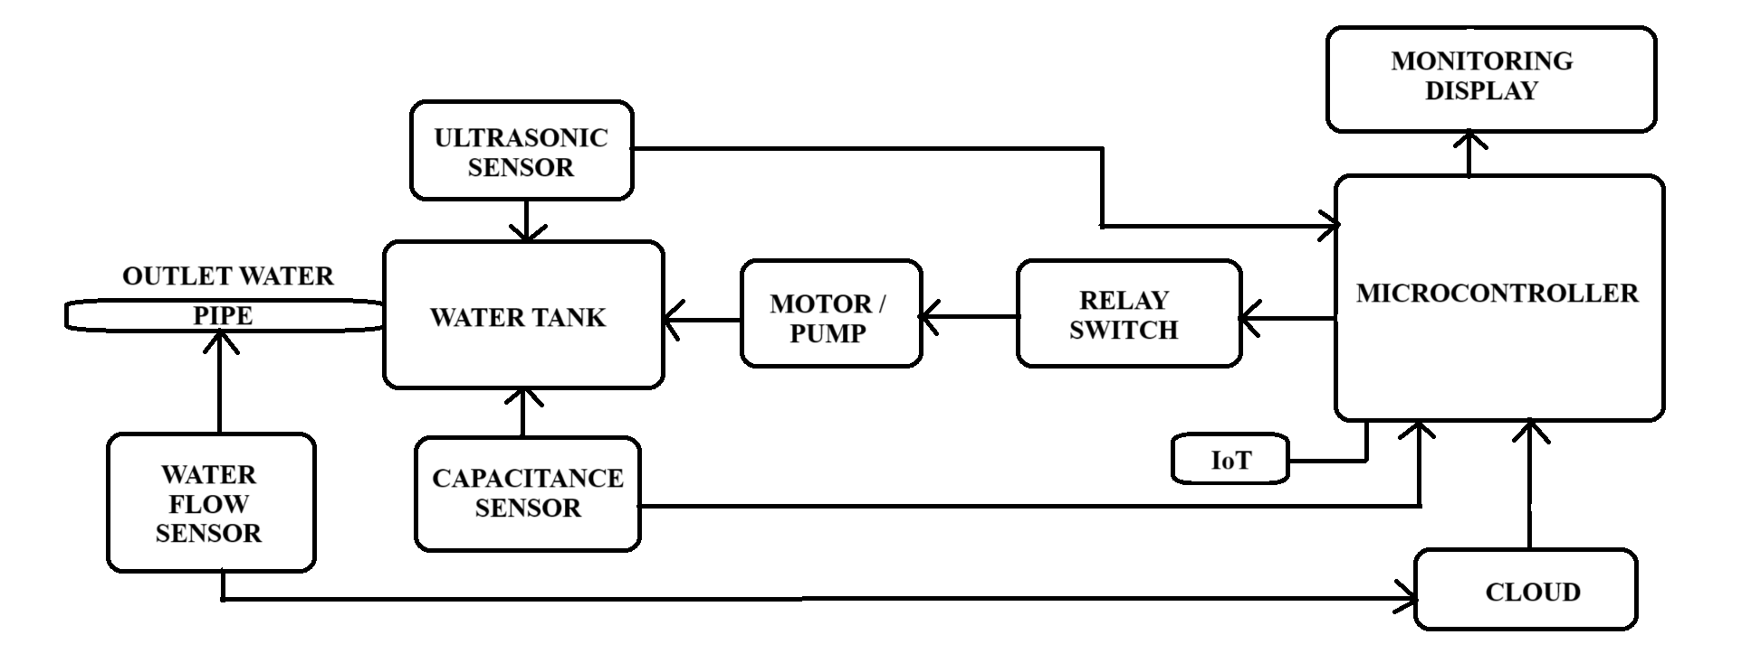
DESIGN

Slide 3
WORKING PRINCIPLE
Design of the system is shown in the above figure.
In this system , ultrasonic sensor and capacitance sensor is placed in the water tank. Which detects the water level with accuracy.
At the terminal of the water distribution, we have fixed the water flow sensor , to measure the spending quantity of the water. And that data will be stored in cloud .
The output of the ultrasonic sensor and capacitance sensor would be driven to the microcontroller.
When the water level is completed , the motor will be turned off by using the relay switch with the help of ultrasonic sensors.
When the water level is low, motor will be turned on with the help of capacitance sensor by using the relay switch.
The IoT based microcontroller is placed here to perform the above conditions.
User could able to monitor the water level at any time and also could analyse their day to day water usage data , which is stored in cloud .

